Slide 1

Parsons Early Head Start Program
2022-2023 Annual Report
60 Academy road
Albany, new York 12208
518.426.2600
www.northernrivers.org

Slide 3
Parsons Early Head Start Enrollment
Parsons Child and Family Center, a program of Northern Rivers Family of Services, provides Early Head Start (EHS) services to pregnant women and families with children under the age of 3 who live in Schenectady County and are at or below federal guidelines for poverty
Funded Enrollment of 94 children: 22 served with a Home Visiting Model and 72 served with a Center-based Model in 9 classrooms located at 125 Bigelow Avenue, Schenectady, NY
Total number served: 135 Children, 116 families, 5 pregnant women
Average monthly enrollment (August 2022-July 2023): 59 children*
The average monthly wait list was 94 children over this 12-month period
*Program enrollment was negatively impacted by staffing vacancies and decreased interest in home-based services

Slide 4
Parsons Early Head Start Enrollment

Slide 5
Early Intervention:
REFERRALS & services
Children receiving Early Intervention Services: 19 children
  9 children were enrolled with services
  prior to enrollment
  10 children were approved for services
  after enrollment

Slide 6
Early head start services
Early childhood/child development education, screenings, referrals
Assistance with early intervention services
Family support and home visiting
Health education, screening, referrals
Dental education, screening, referrals
Mental Health education, screening, referrals
Connection to community resources
Opportunities for program governance
Group socialization opportunities for families
Parent support groups

Slide 7
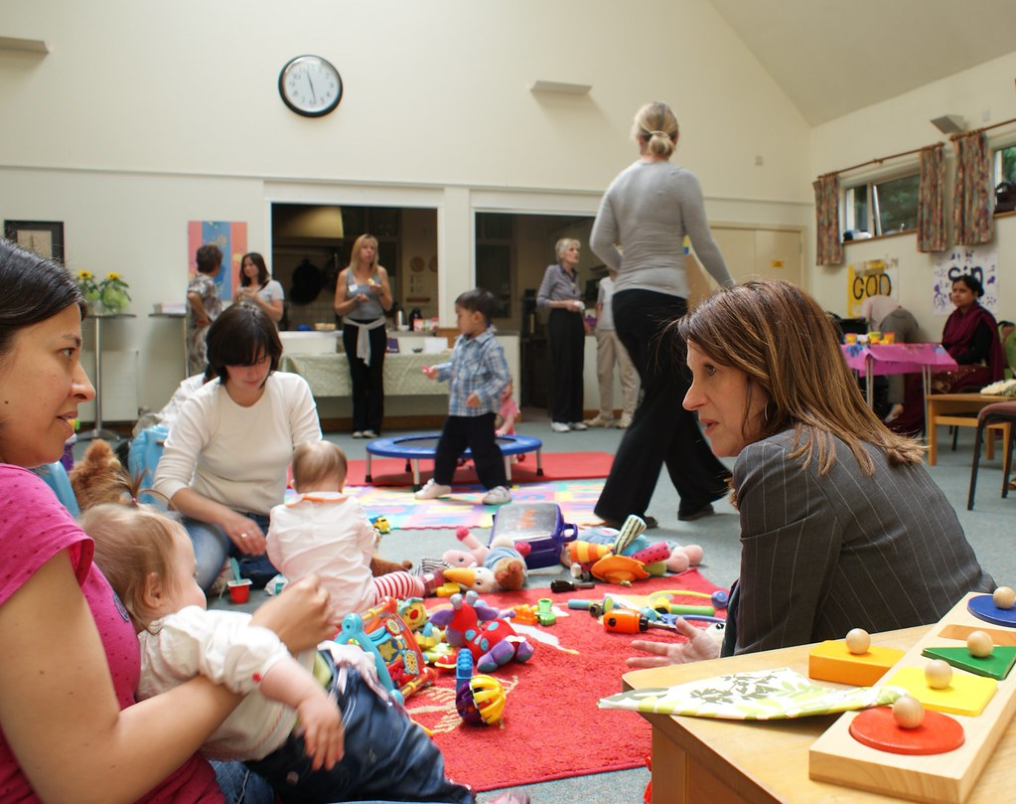
Parent involvement activities
Regular Socialization Groups
Parent Involvement Opportunities
Weekly Parent’s Support Group
Monthly Policy Council Meetings
Monthly Parent Committee Meetings
Community Day for Children and Parents
Nutrition Trainings
Many More Activities

Slide 8
School readiness: preparing for kindergarten
School readiness focused on five domains
Child progress measured with the Creative Curriculum Gold Assessment and the Devereux Early Childhood Assessment
Children assessed for developmental and social emotional progress 3 times per year. Progress monitored individually and programmatically

Slide 9
Tracking Progress towards school readiness goals

Slide 10
Enrolled Children Receiving Medical and Dental Exams
Medical Exams
Dental Exams

Slide 11
Revenue:
Public & Private Funds to Support Early Head Start Program
2022-2023 Funding Report
U.S. Department of Health and Human Services | $1,808,186
U.S. Department of Agriculture* *Passed through New York State Department of Health | $68,693
Non-Federal Share (Cash)
Schenectady County Day Care Subsidy | $175,731
Client Fee Income | $7,152
Private Donations | $35,000
Total Revenue |  | $2,094,762
Non-Federal Share In-Kind (Non Cash) | $214,864
Total Revenue per Federal Standards |  | $2,309,626

Slide 12
EXPENSES: budget–to–actual expenditures Comparison for FY May 2022-April 2023
Expense | Budget $ | Actual $ | Variance $ | Proposed 2023-2024 $
Personnel | 1,132,706 | 1,221,763 | (89,057) | 1,203,521
Fringe | 277,513 | 236,243 | 41,270 | 294,861
Occupancy | 110,697 | 183,918 | (73,221) | 112,738
Food | 44,707 | 76,899 | (32,192) | 90,106
Transportation | 3,350 | 10,572 | (7,222) | 4,000
Staff Development/Training | 37,098 | 47,361 | (10,263) | 37,098
Insurance | 20,191 | 21,913 | (1,722) | 21,977
Telephone/Postage/Photocopying | 7,451 | 7,408 | 43 | 7,582
Supplies | 37,692 | 48,570 | (10,878) | 33,771
Other | 245,493 | 282,779 | (37,286) | 249,173
In-Kind (non-cash) | 339,568 | 214,864 | 124,704 | 328,641
Total | 2,256,466 | 2,352,290 | (95,824) | 2,383,468

Slide 13
Federal Review and Audit
Federal Review – Focus Area 1 Monitoring Review conducted in March of 2020
Federal Review – Focus Area 2 Monitoring Review conducted in June of 2021
The program was fully in compliance for both reviews.

